Slide 1
1
SRS for BLOG WEBSITE AND APPLICATION
By
B.Balamurugan Rajalakshmi Institute of Technology
LMS Usernames | Name | Batch
2113a4923 | B.Balamurugan | A49

Slide 2
2
Table of Contents
INTRODUCTION
Objective
Scope
Glossary
OVERALL DESCRIPTION
Product Perspective
Hardware Requirements
Software Requirements
FUNCTIONAL REQUIREMENT
Book Management
Non-Function Requirement
Usability
Availability
Efficiency
Accuracy
Performance
Reliability
USER CHARACTERSTICS
DIAGRAM
Use Case Diagram
Class Diagram
State Diagram
Sequence Diagram
Data flow Diagram

Slide 3
3
INTRODUCTION
You've probably heard of blogging. You may have read or heard a tale about a blogger finding information on a politician or hot-button issue. You could have even read a book or watched a movie that was based on a blog. In any case, what precisely is a blog?You will learn about blogs and bloggers in this class. You'll also learn about a few popular blog categories and discover the motivations behind bloggers.
Objective
This kind of material may be used for many different purposes and objectives, from growing brand recognition to cultivating leads. Prior to developing a blog content plan, having a firm grasp of your marketing goals will enable you to make the best choices for both broad campaigns and specific blog entries.
SCOPE
The primary component of the project scope statement is the project scope. It should provide details like the budget, schedule, or participating teams. Also, you may present a vision for the outcomes. Include something along the lines of, "This project will involve research, content strategy, content development, and content posting on the corporate blog.
Glossary
React -> JavaScript library
Json -> JavaScript Object Notation
DFD -> Data Flow Diagram
FD -> Context Flow Diagram ER -> Entity Relationship
IDE -> Integrated Development Environment SRS -> Software Requirement Specification

Slide 4
4
OVERALL DESCRIPTION
PRODUCT PRESPECTIVE
Selecting the appropriate niche is crucial when starting a blog for product reviews. Either you should have experience in that field, or you should employ writers who are competent. Nothing, in my opinion, is worse than reading a product review from a writer who is either unqualified to review the product or has never used it.
SOFTWARE REQUIREMENT
Front end:
React js
Back end:
Json
2.3 HARDWARE REQUIREMENT
Visual Studio 2GB ram ,1.2 GHz ,
processorIntel i5 Windows 7/8/8.1/10

Slide 5
5
FUNCTIONAL REQUIREMENT
User registration and login: Users should be able to create an account and log in to the blog website to access their dashboard.
Blog creation: Users should be able to create a new blog post by adding a title, content, tags, and images.
Blog editing: Users should be able to edit their published blog posts, change the title, content, tags, and images.
Blog management: Users should be able to manage their blog posts, delete, archive, or mark as private.
Search functionality: Users should be able to search for blogs based on keywords or tags.
Social sharing: Users should be able to share their blog posts on social media platforms like Facebook, Twitter, and LinkedIn.
Comment system: Users should be able to add comments to blog posts and reply to other users' comments.
Notification system: Users should receive notifications when someone comments on their blog post, or when their blog post is featured or shared.
Blog categories: Users should be able to categorize their blog posts into different categories for easy access and organization.
User profile: Users should have a profile page that displays their bio, photo, and a list of their published blog posts.
Analytics: The website should have analytics to track the number of views, likes, and comments on each blog post, and provide insights to the user.
User feedback: The website should allow users to provide feedback and rate blog posts, to help improve the content quality.
Mobile compatibility: The website should be optimized for mobile devices, allowing users to access the blog on-the-go.
SEO optimization: The website should be optimized for search engines, with
features like meta tags, descriptions, and URL structure.
Multi-language support: The website should support multiple languages to cater to a global audience.

Slide 6
6
2.4.1 Non Functional Requirements
Usability: The website should have an intuitive and user-friendly interface that is easy to navigate, with clear labels and instructions for users.
Performance: The website should load quickly and efficiently, with minimal latency and downtime, to ensure a seamless user experience.
Security: The website should have robust security measures in place to protect user data, prevent unauthorized access, and mitigate cyber attacks.
Accessibility: The website should be designed with accessibility in mind, making
it easy for users with disabilities to access and navigate the content.
Reliability: The website should be reliable and dependable, with high availability and minimal errors or disruptions.
Scalability: The website should be scalable, with the ability to handle a growing user base and increasing traffic without compromising performance.
Compatibility: The website should be compatible with different web browsers, operating systems, and devices, to ensure broad accessibility and usability.
Maintainability: The website should be easy to maintain and update, with clear
documentation, modular architecture, and efficient code.
Internationalization: The website should support internationalization, with the ability to display content in different languages, currencies, and time zones.
Compliance: The website should comply with relevant laws, regulations, and industry standards, such as data protection laws, copyright laws, and web accessibility guidelines.
10.5
USER CHARACTERSTICS
We have 3 levels of users :
User module: In the user module, user will check the availability of the blog.
Issue blog
▪
Fine details

Slide 7
7
10.6 CONSTRAINTS
Technical constraints: The blog website and application must be compatible with different web browsers and devices, and adhere to web standards and best practices. It may also be constrained by the available server resources, such as storage, processing power, and bandwidth.
Time constraints: The blog website and application may be subject to time constraints, such as a deadline for launch or a timeline for updates and maintenance.
Budget constraints: The development and maintenance of the blog website and application may be constrained by available resources, such as budget or personnel.
Legal constraints: The blog website and application must comply with relevant laws and regulations, such as data protection laws, copyright laws, and web accessibility guidelines.
Content constraints: The blog website and application may be constrained by the available content, including images, videos, and other multimedia. It must also adhere to ethical and professional standards for content creation and publishing.
User constraints: The blog website and application must be designed with the user in mind, including their technical abilities, language proficiency, and accessibility needs.
Security constraints: The blog website and application must be designed with security in mind, to protect user data, prevent unauthorized access, and mitigate cyber attacks.
Performance constraints: The blog website and application must be designed to perform optimally under different conditions, including high traffic volumes and variable network conditions.

Slide 8
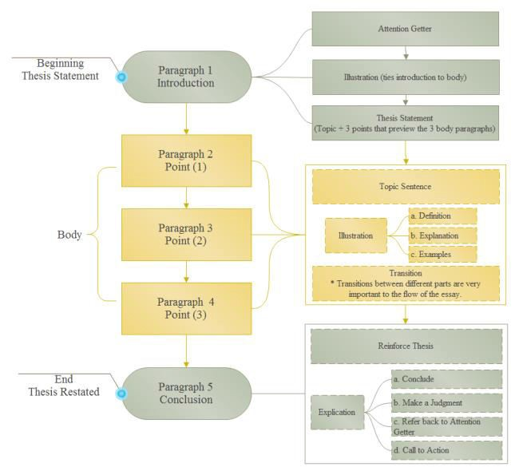
8
FLOW DIAGRAM

Slide 9
9
10.7
USE CASE MODEL DESCRIPTION:
Use Case selection | Description
Use Case name | Add blog website and application
Level | Sub-Functional level
Primary actor | user, manager
Stakeholders and interest |  | Content creators: Content creators are stakeholders who create the blog content, and their interests may include having an easy-to-use content management system, access to analytics, and the ability to customize the appearance and layout of the blog. Website administrators: Website administrators are stakeholders who manage the blog website and application, and their interests may include maintaining the security and performance of the website, managing user accounts, and monitoring website traffic and user behavior
Pre-condition | Students and Library have submitted their registration form.
Post-condition | Record for a user/blog has been added.
Main success scenario | A user visits the blog website and finds it easy to navigate and search for content. The user discovers high-quality and relevant content that meets their interests and needs. The user engages with the content by leaving comments, sharing it on social media, or subscribing to the blog. The user returns to the blog website regularly to consume new content and engage with other users. The blog website attracts a growing user base, resulting in increased traffic and engagement.

Slide 10
1
Alternative flow | 1 User/blog opens the application in their phone2 He/She tries to sign-up He/She fails and receives an error He/She will report an error and the error will be rectifiedas soon as possible.
Specific requirement | The response time for registration is 1 minute. The response time for login is 1 minute

Slide 11
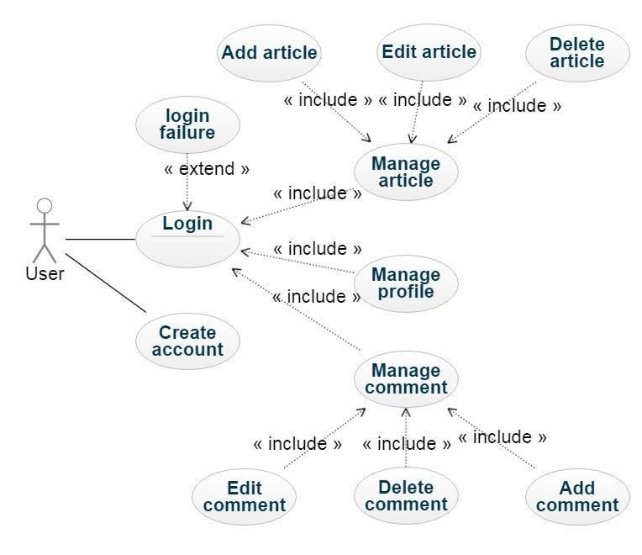
9
2.9.1 USE CASE DIAGRAM

Slide 12
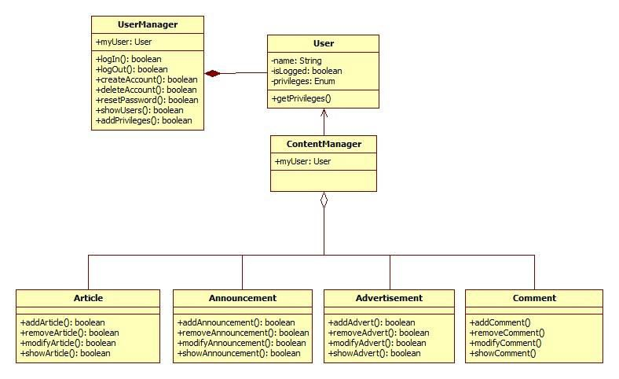
9
2.9.2 CLASS DIAGRAM
Fig 2. Class diagram

Slide 13
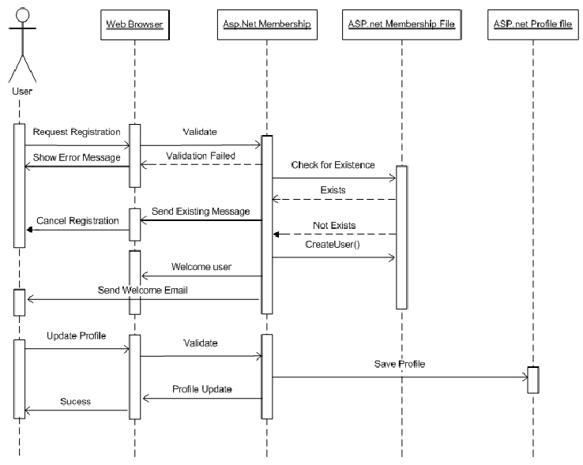
10
2.9.3 Sequential diagram

Slide 14
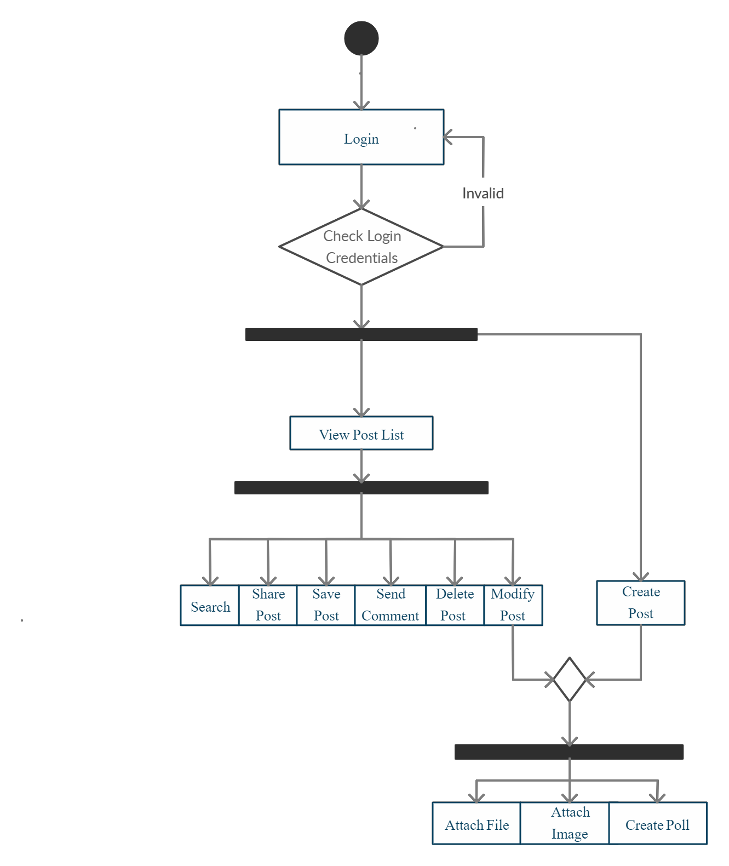
11
2.9.4 ACTIVTY DIAGRAM

Slide 15
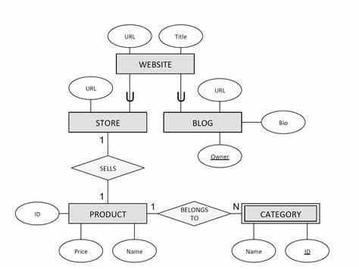
12
2.10 ER diagram
Assumptions and Dependencies
The product needs following third party applications for the development of the project:
Json
Visual Studio
Photoshop (for editing layouts, icons, buttons, etc)

Slide 16
Github link: https://github.com/bala28-01/full-stack.git
Github repository

Slide 17


